Slide 1
Asymptotes and Other Discontinuities

Slide 2
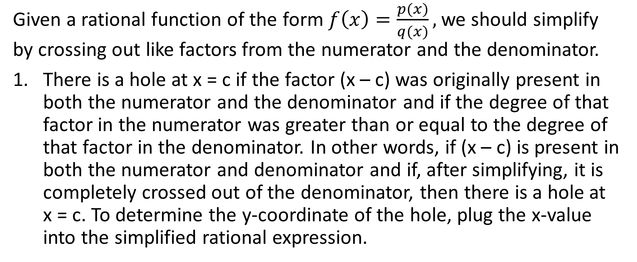
Testing for Vertical Asymptotes and Holes
Given a rational function of the form $f\left(x\right)=\frac{p(x)}{q(x)},$we should simplify by crossing out like factors from the numerator and the denominator.
There is a hole at x = c if the factor (x – c) was originally present in both the numerator and the denominator and if the degree of that factor in the numerator was greater than or equal to the degree of that factor in the denominator. In other words, if (x – c) is present in both the numerator and denominator and if, after simplifying, it is completely crossed out of the denominator, then there is a hole at x = c. To determine the y-coordinate of the hole, plug the x-value into the simplified rational expression.

Slide 3
2. There’s a vertical asymptote at x = c if, AFTER SIMPLIFYING, the
denominator equals 0 at x = c and the numerator does not equal 0
at x = c.

Slide 4
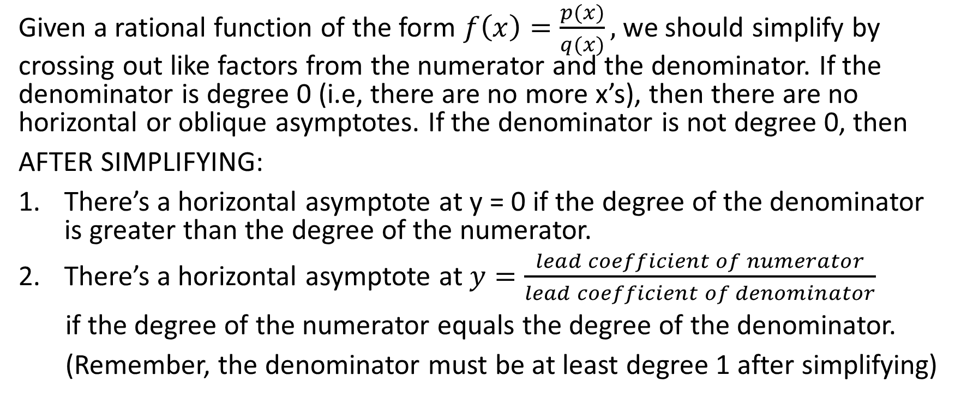
Test for Horizontal and Oblique Asymptotes
Given a rational function of the form $f\left(x\right)=\frac{p(x)}{q(x)},$we should simplify by crossing out like factors from the numerator and the denominator. If the denominator is degree 0 (i.e, there are no more x’s), then there are no horizontal or oblique asymptotes. If the denominator is not degree 0, then
AFTER SIMPLIFYING:
There’s a horizontal asymptote at y = 0 if the degree of the denominator is greater than the degree of the numerator.
There’s a horizontal asymptote at $y=\frac{lead coefficient of numerator}{lead coefficient of denominator}$
if the degree of the numerator equals the degree of the denominator.
(Remember, the denominator must be at least degree 1 after simplifying)

Slide 5
There’s an oblique asymptote if the degree of the numerator is
greater than the degree of the denominator. To determine the
equation of the oblique asymptote, we use synthetic division or
long division.

Slide 6
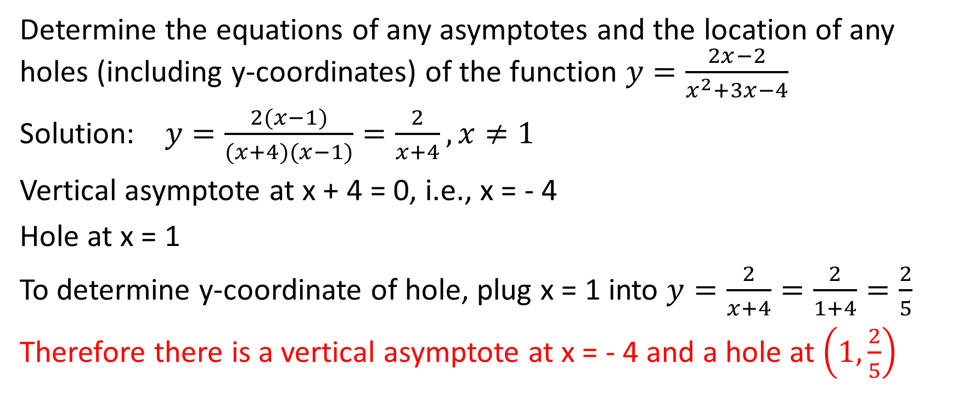
Example
Determine the equations of any asymptotes and the location of any holes (including y-coordinates) of the function $y=\frac{2x−2}{x^{2}+3x−4}$
Solution: $y=\frac{2(x−1)}{(x+4)(x−1)}=\frac{2}{x+4},x≠1$
Vertical asymptote at x + 4 = 0, i.e., x = - 4
Hole at x = 1
To determine y-coordinate of hole, plug x = 1 into $y=\frac{2}{x+4}=\frac{2}{1+4}=\frac{2}{5}$
Therefore there is a vertical asymptote at x = - 4 and a hole at $\left(1,\frac{2}{5}\right)$

Slide 7
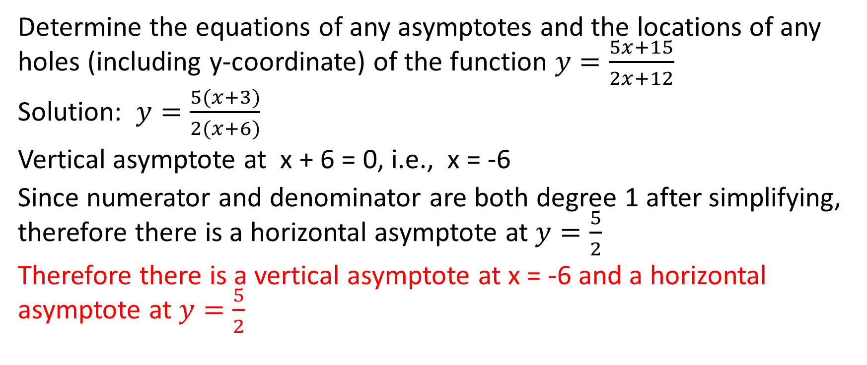
Example
Determine the equations of any asymptotes and the locations of any holes (including y-coordinate) of the function $y=\frac{5x+15}{2x+12}$
Solution: $y=\frac{5(x+3)}{2(x+6)}$
Vertical asymptote at x + 6 = 0, i.e., x = -6
Since numerator and denominator are both degree 1 after simplifying, therefore there is a horizontal asymptote at $y=\frac{5}{2}$
Therefore there is a vertical asymptote at x = -6 and a horizontal asymptote at $y=\frac{5}{2}$

Slide 8
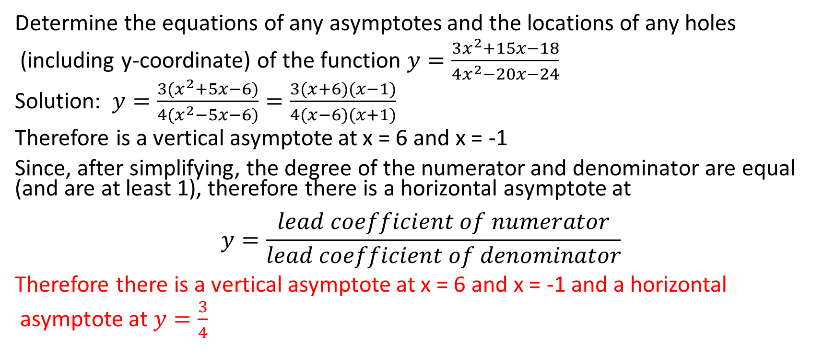
Example
Determine the equations of any asymptotes and the locations of any holes
(including y-coordinate) of the function $y=\frac{3x^{2}+15x−18}{4x^{2}−20x−24}$
Solution: $y=\frac{3(x^{2}+5x−6)}{4(x^{2}−5x−6)}=\frac{3(x+6)(x−1)}{4(x−6)(x+1)}$
Therefore is a vertical asymptote at x = 6 and x = -1
Since, after simplifying, the degree of the numerator and denominator are equal (and are at least 1), therefore there is a horizontal asymptote at
$$y=\frac{lead coefficient of numerator}{lead coefficient of denominator}$$
Therefore there is a vertical asymptote at x = 6 and x = -1 and a horizontal
asymptote at $y=\frac{3}{4}$

Slide 9
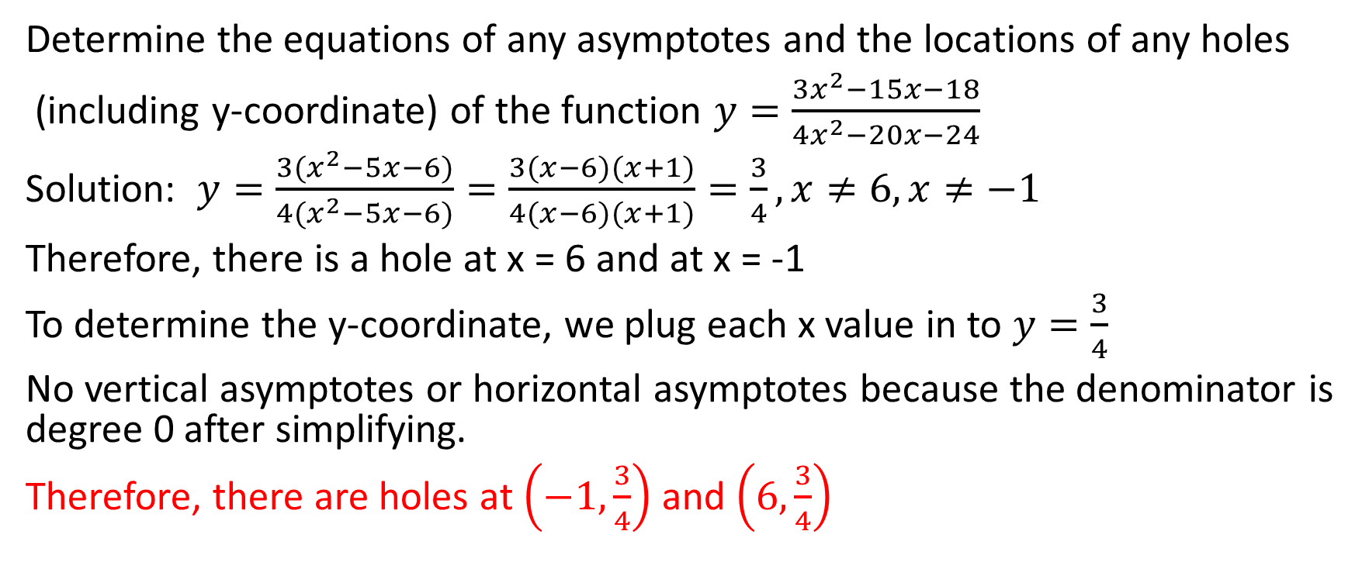
Example
Determine the equations of any asymptotes and the locations of any holes
(including y-coordinate) of the function $y=\frac{3x^{2}−15x−18}{4x^{2}−20x−24}$
Solution: $y=\frac{3(x^{2}−5x−6)}{4(x^{2}−5x−6)}=\frac{3(x−6)(x+1)}{4(x−6)(x+1)}=\frac{3}{4},x≠6,x≠−1$
Therefore, there is a hole at x = 6 and at x = -1
To determine the y-coordinate, we plug each x value in to $y=\frac{3}{4}$
No vertical asymptotes or horizontal asymptotes because the denominator is degree 0 after simplifying.
Therefore, there are holes at $\left(−1,\frac{3}{4}\right)$ and $\left(6,\frac{3}{4}\right)$

Slide 10
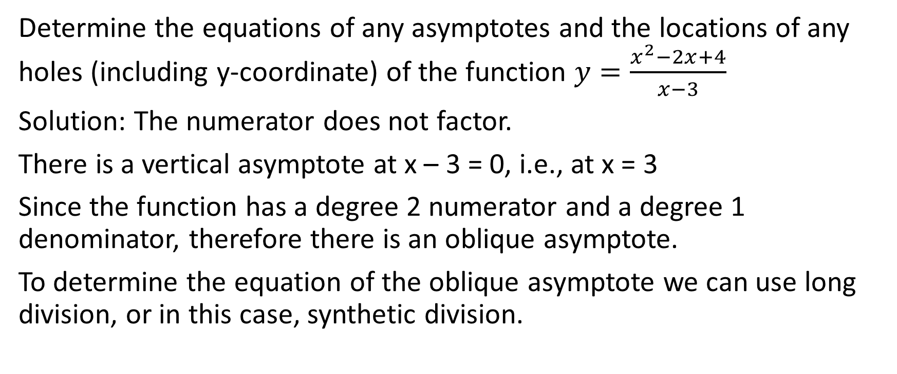
Example
Determine the equations of any asymptotes and the locations of any holes (including y-coordinate) of the function $y=\frac{x^{2}−2x+4}{x−3}$
Solution: The numerator does not factor.
There is a vertical asymptote at x – 3 = 0, i.e., at x = 3
Since the function has a degree 2 numerator and a degree 1 denominator, therefore there is an oblique asymptote.
To determine the equation of the oblique asymptote we can use long division, or in this case, synthetic division.

Slide 11





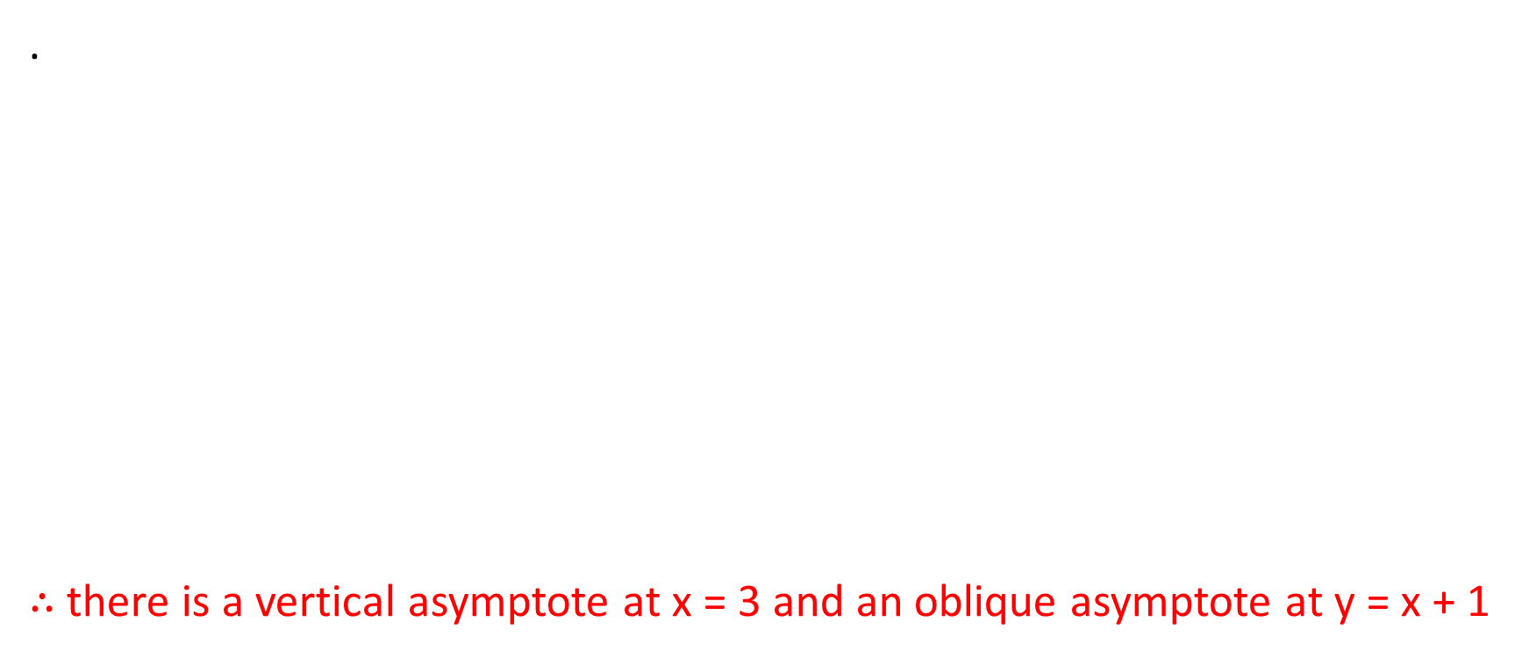




.
$∴$ there is a vertical asymptote at x = 3 and an oblique asymptote at y = x + 1

Slide 12
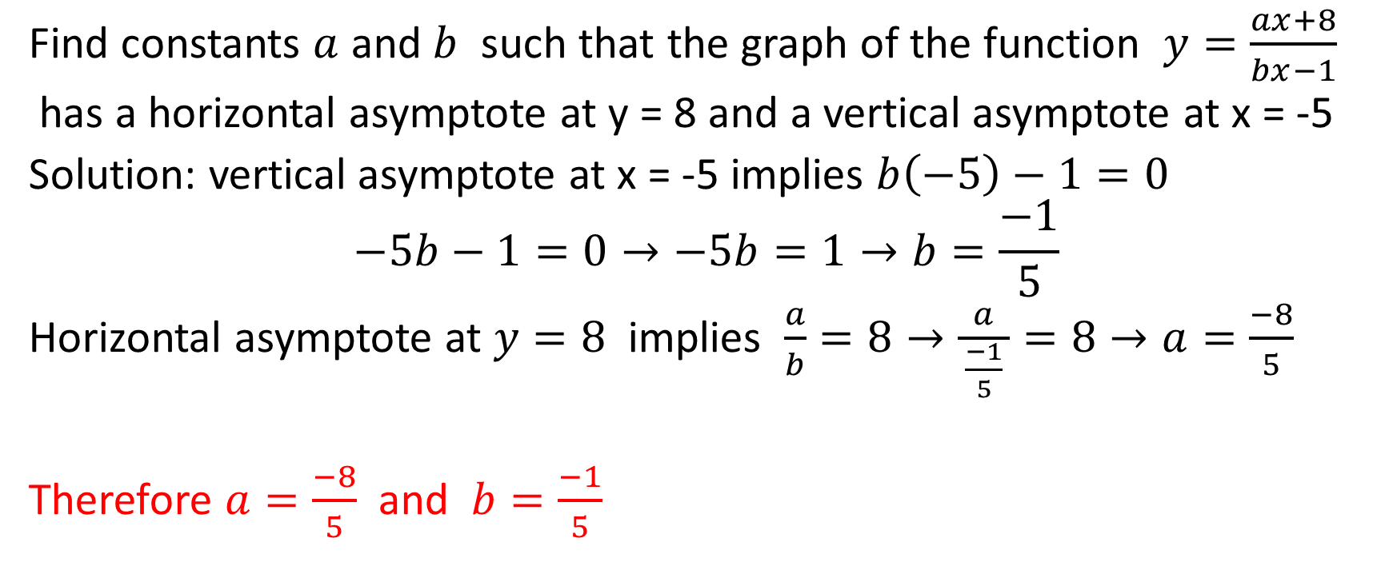
Example
Find constants $a$ and $b$ such that the graph of the function $y=\frac{ax+8}{bx−1}$
has a horizontal asymptote at y = 8 and a vertical asymptote at x = -5
Solution: vertical asymptote at x = -5 implies $b\left(−5\right)−1=0$
$$−5b−1=0→−5b=1→b=\frac{−1}{5}$$
Horizontal asymptote at $y=8$ implies $\frac{a}{b}=8→\frac{ a }{\frac{−1}{5}}=8→a=\frac{−8}{5}$
Therefore $a=\frac{−8}{5}$ and $b=\frac{−1}{5}$

